Slide 1
Project VIII – Perfomance Engineering
By Jayaraj, Prakash and Schmid

Slide 2
Plans and Expectations
Goal: Getting an idea of
  How our program performs
  Weaknesses and their origin
  Possibilities to improve
Plan: Check our code of assignment 3 for
  Bottlenecks (e.g. in algorithms)
  Waiting time (e.g. by copying from HTD & DTH)
  Performance compared to best possible behaviour

Slide 3
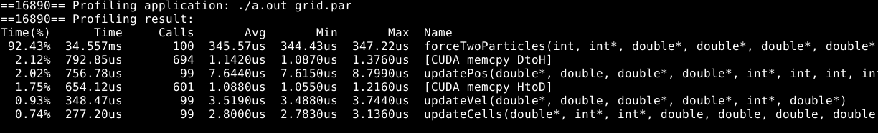
Methods I
Tools:
  NVIDIA Visual Profiler & nvprof
    Check dependencies (waiting time), used kernels, calls of API (f.i. cudaMalloc etc.),
    chronological cycle of program
    Events and metrics (e.g. number of launched warps or used atomic operations)

Slide 4
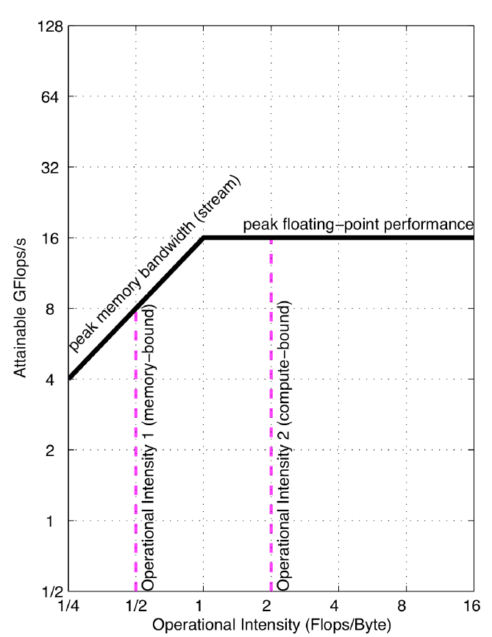
Methods II
How to identify bottlenecks?
  Roofline performance model: unifies floating point performance, operational intensity and memory performance
  We are interested in:
  1. checking if the program is computationally bound or memory bound
  2. measuring traffic between caches and the main memory
  Bounds in the model: Peak floating point performance and peak memory bandwidth (hardware specifications)

